Slide 1


Slide 2

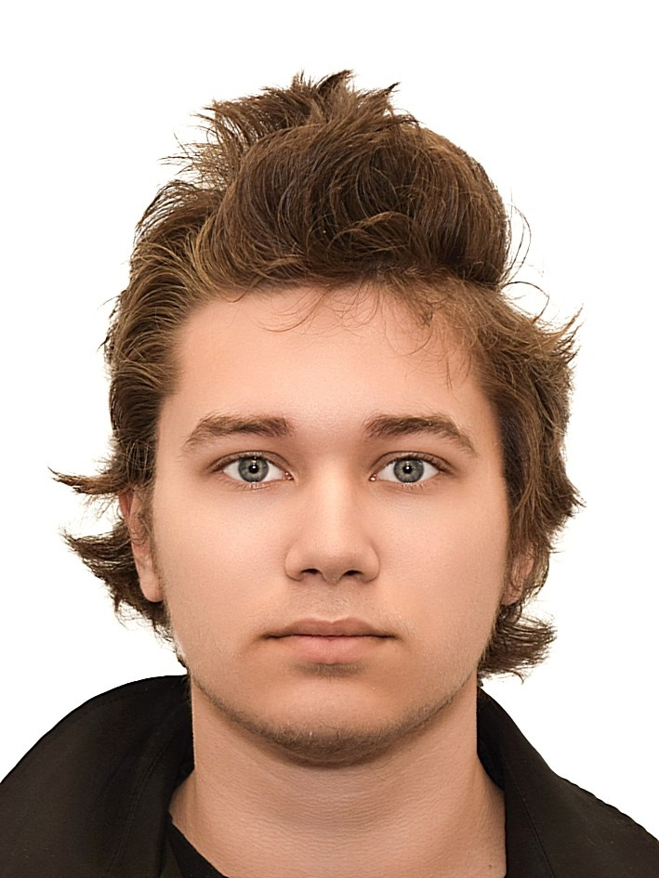

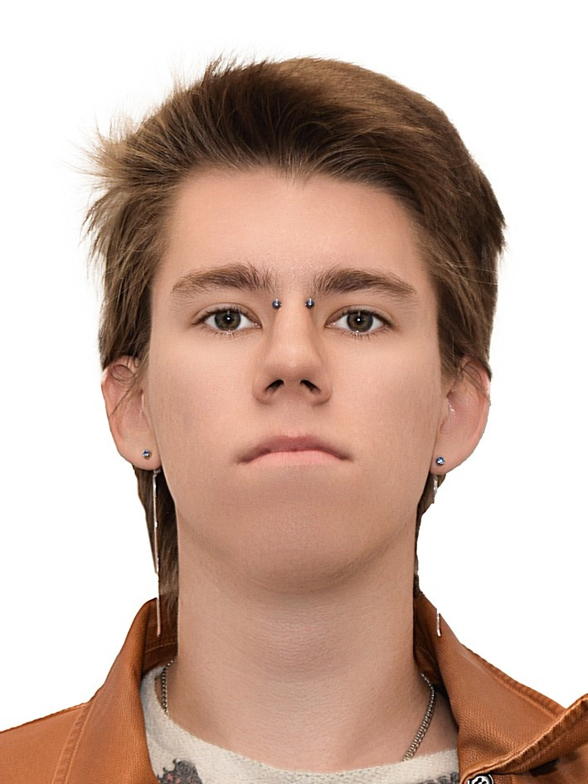

https://github.com/AtomJ2/BirdCLEF

Slide 3
Yaroslav
Chekanov
Alexander
Chebotar
Daniil
Makovetskii
Alexander
Rempel

Slide 4
Our experiments
Short-Time Fourier Transform spectrogram
Mel spectrogram
Constant Q Transform spectrogram
Spectral Contrast spectrogram
Chroma Transform spectrogram
Label smoothing
Augmentations

Slide 5
Models
ResNet182
EfficientNet_b0
*For one-channel images

Slide 6
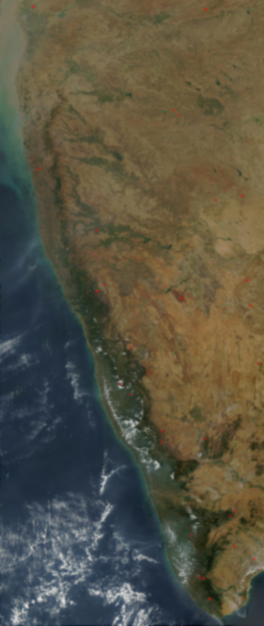

Slide 8
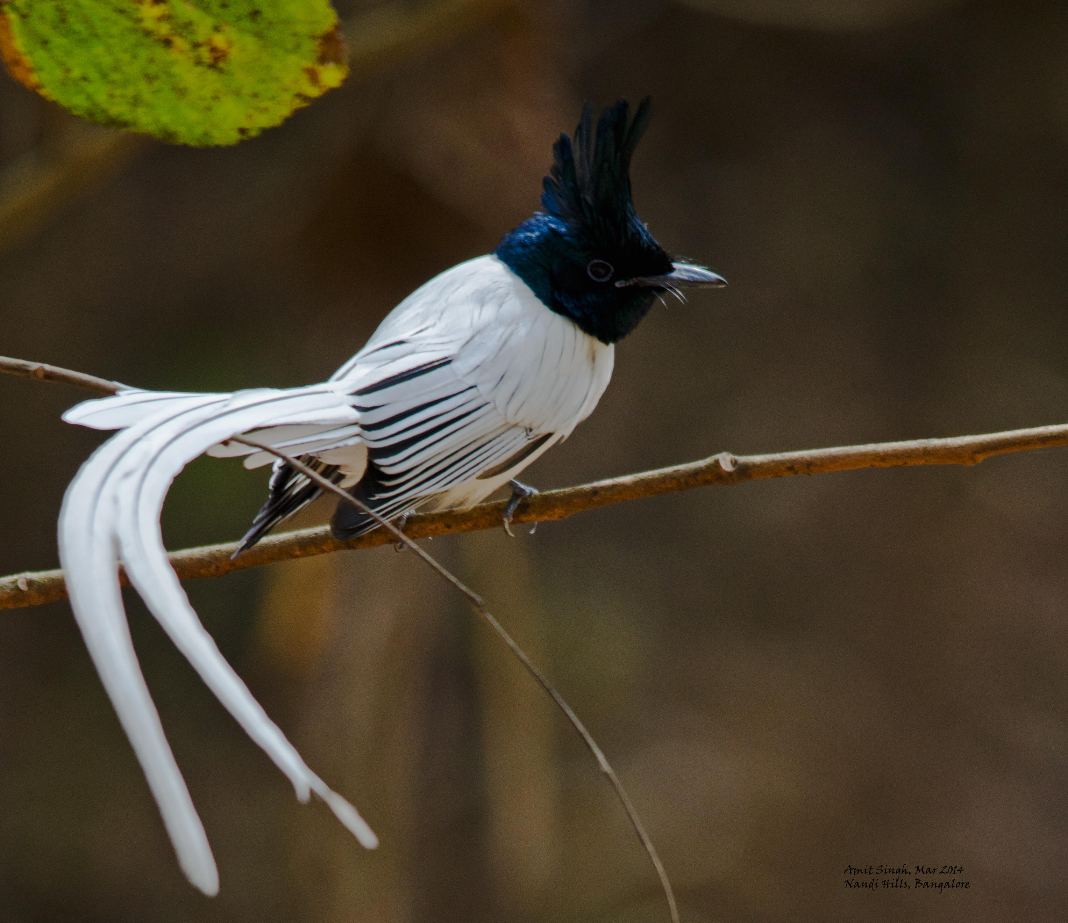

Asian Paradise Flycatcher
Coppersmith Barbet

Slide 10
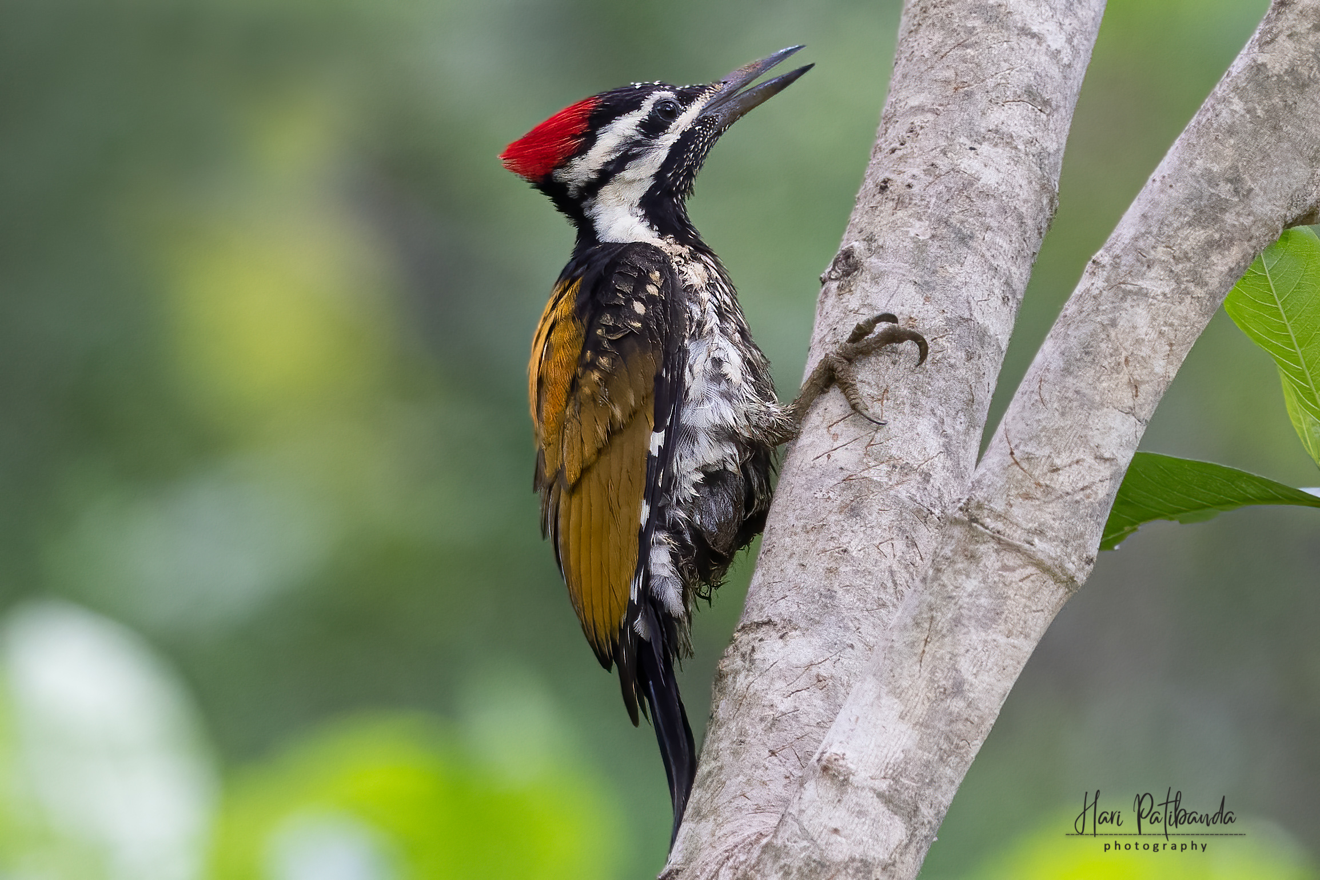
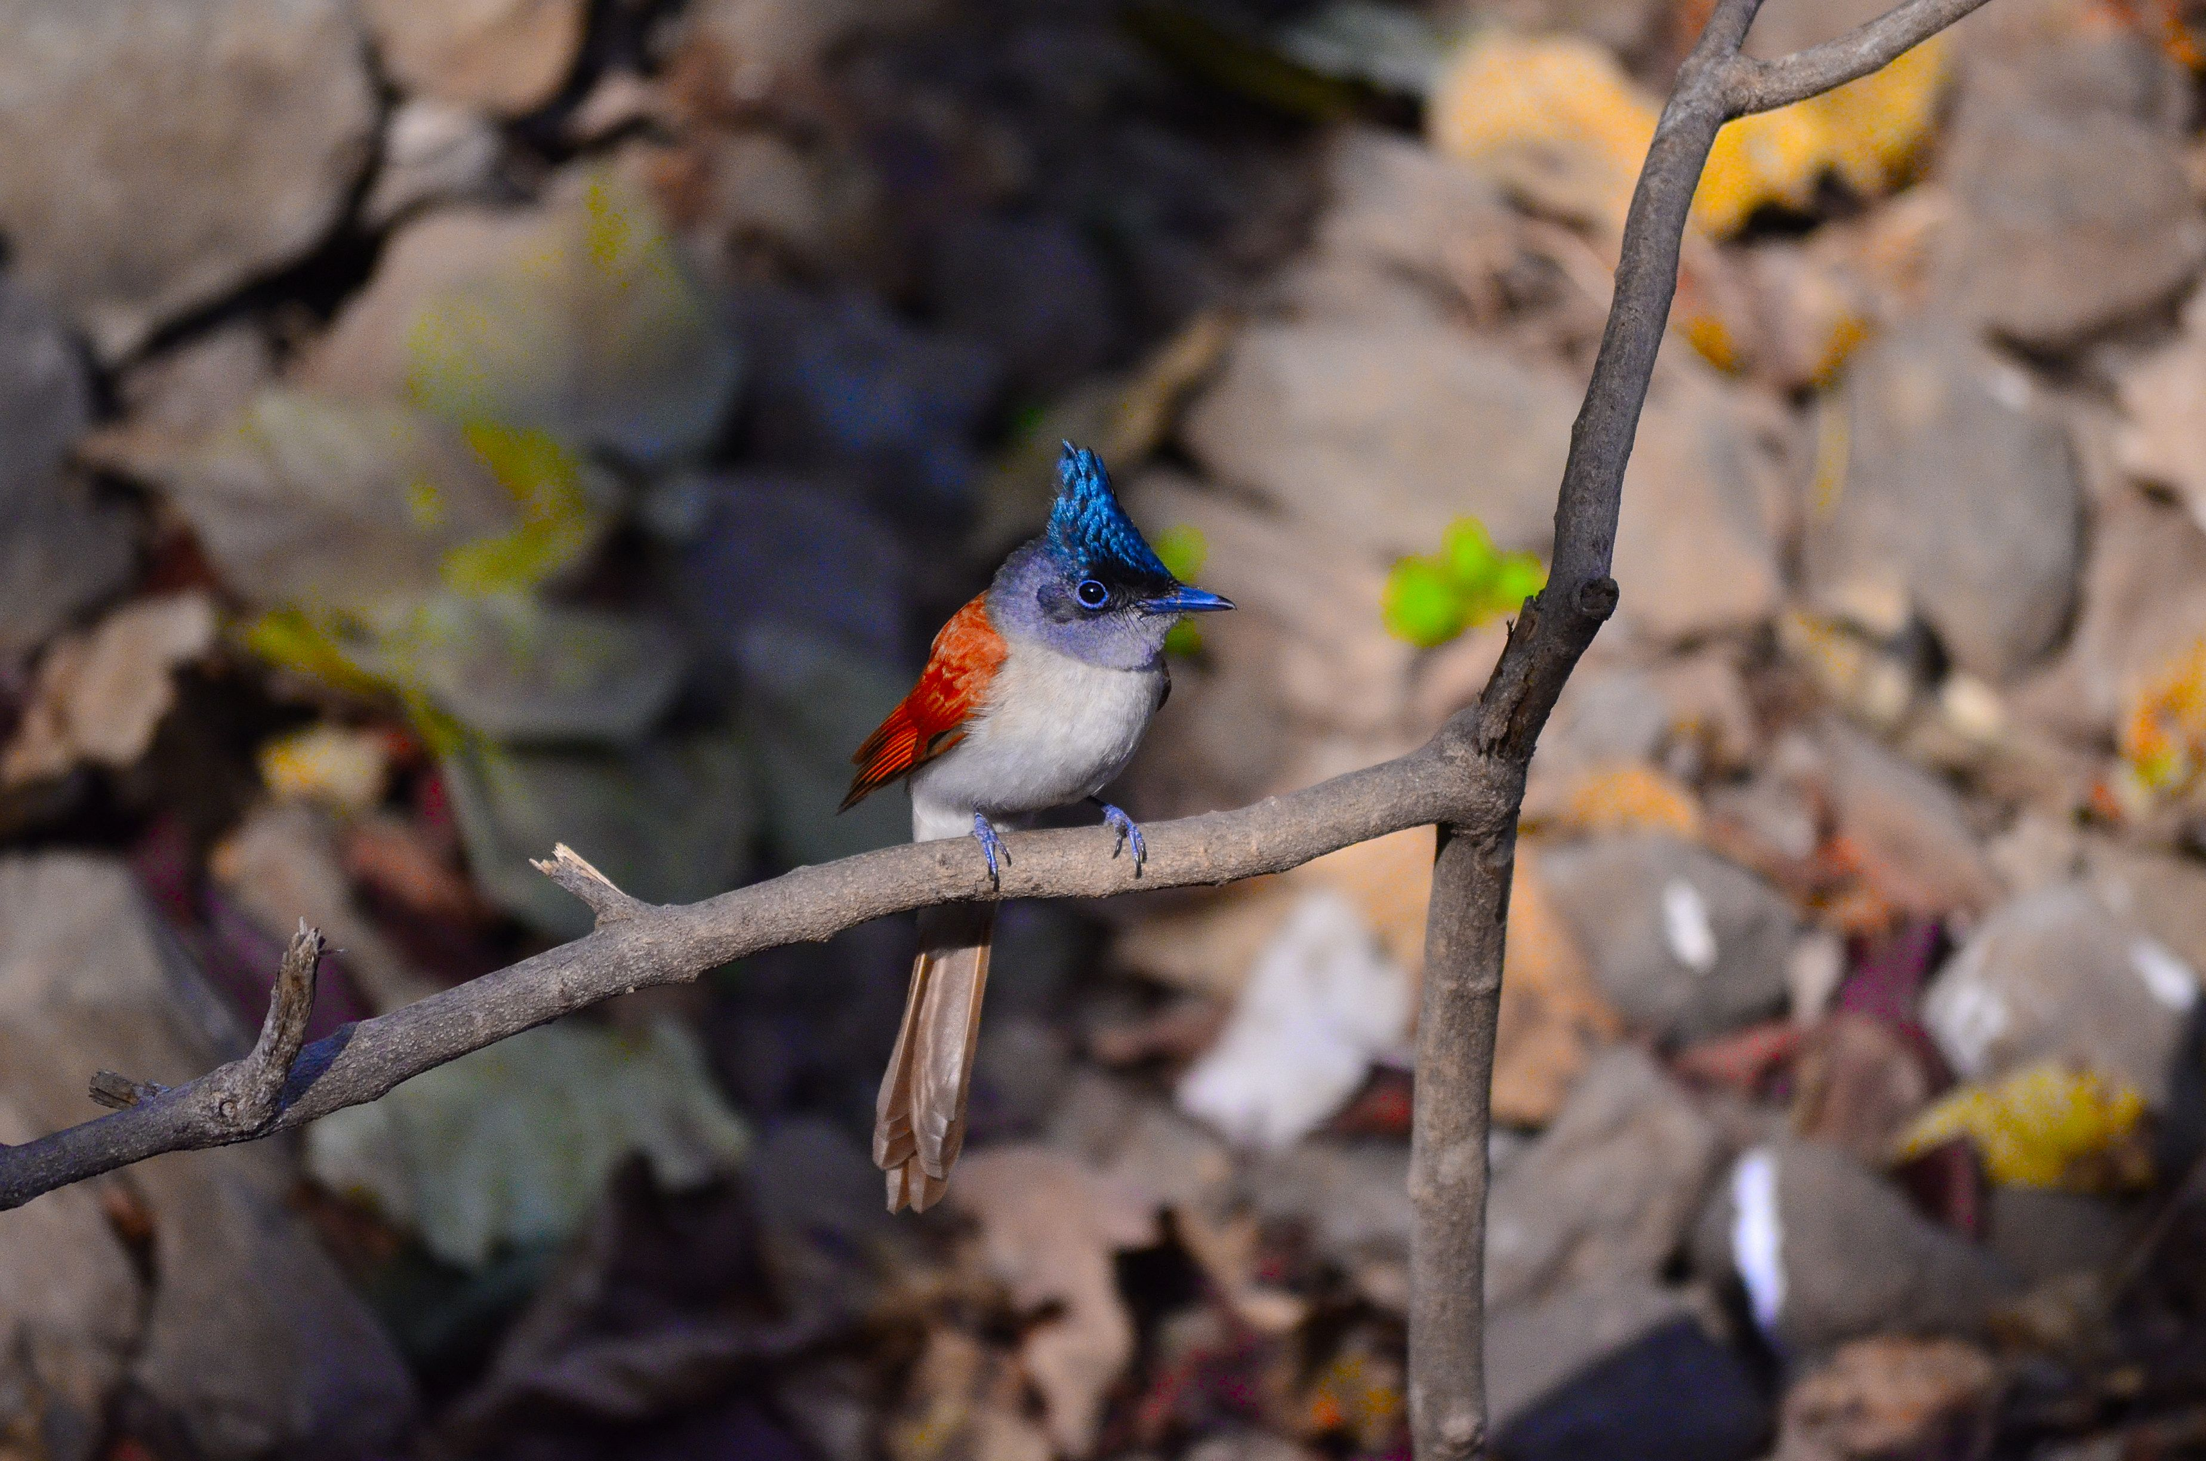
Asian Paradise Flycatcher

Slide 12
Asian Paradise Flycatcher

Slide 14
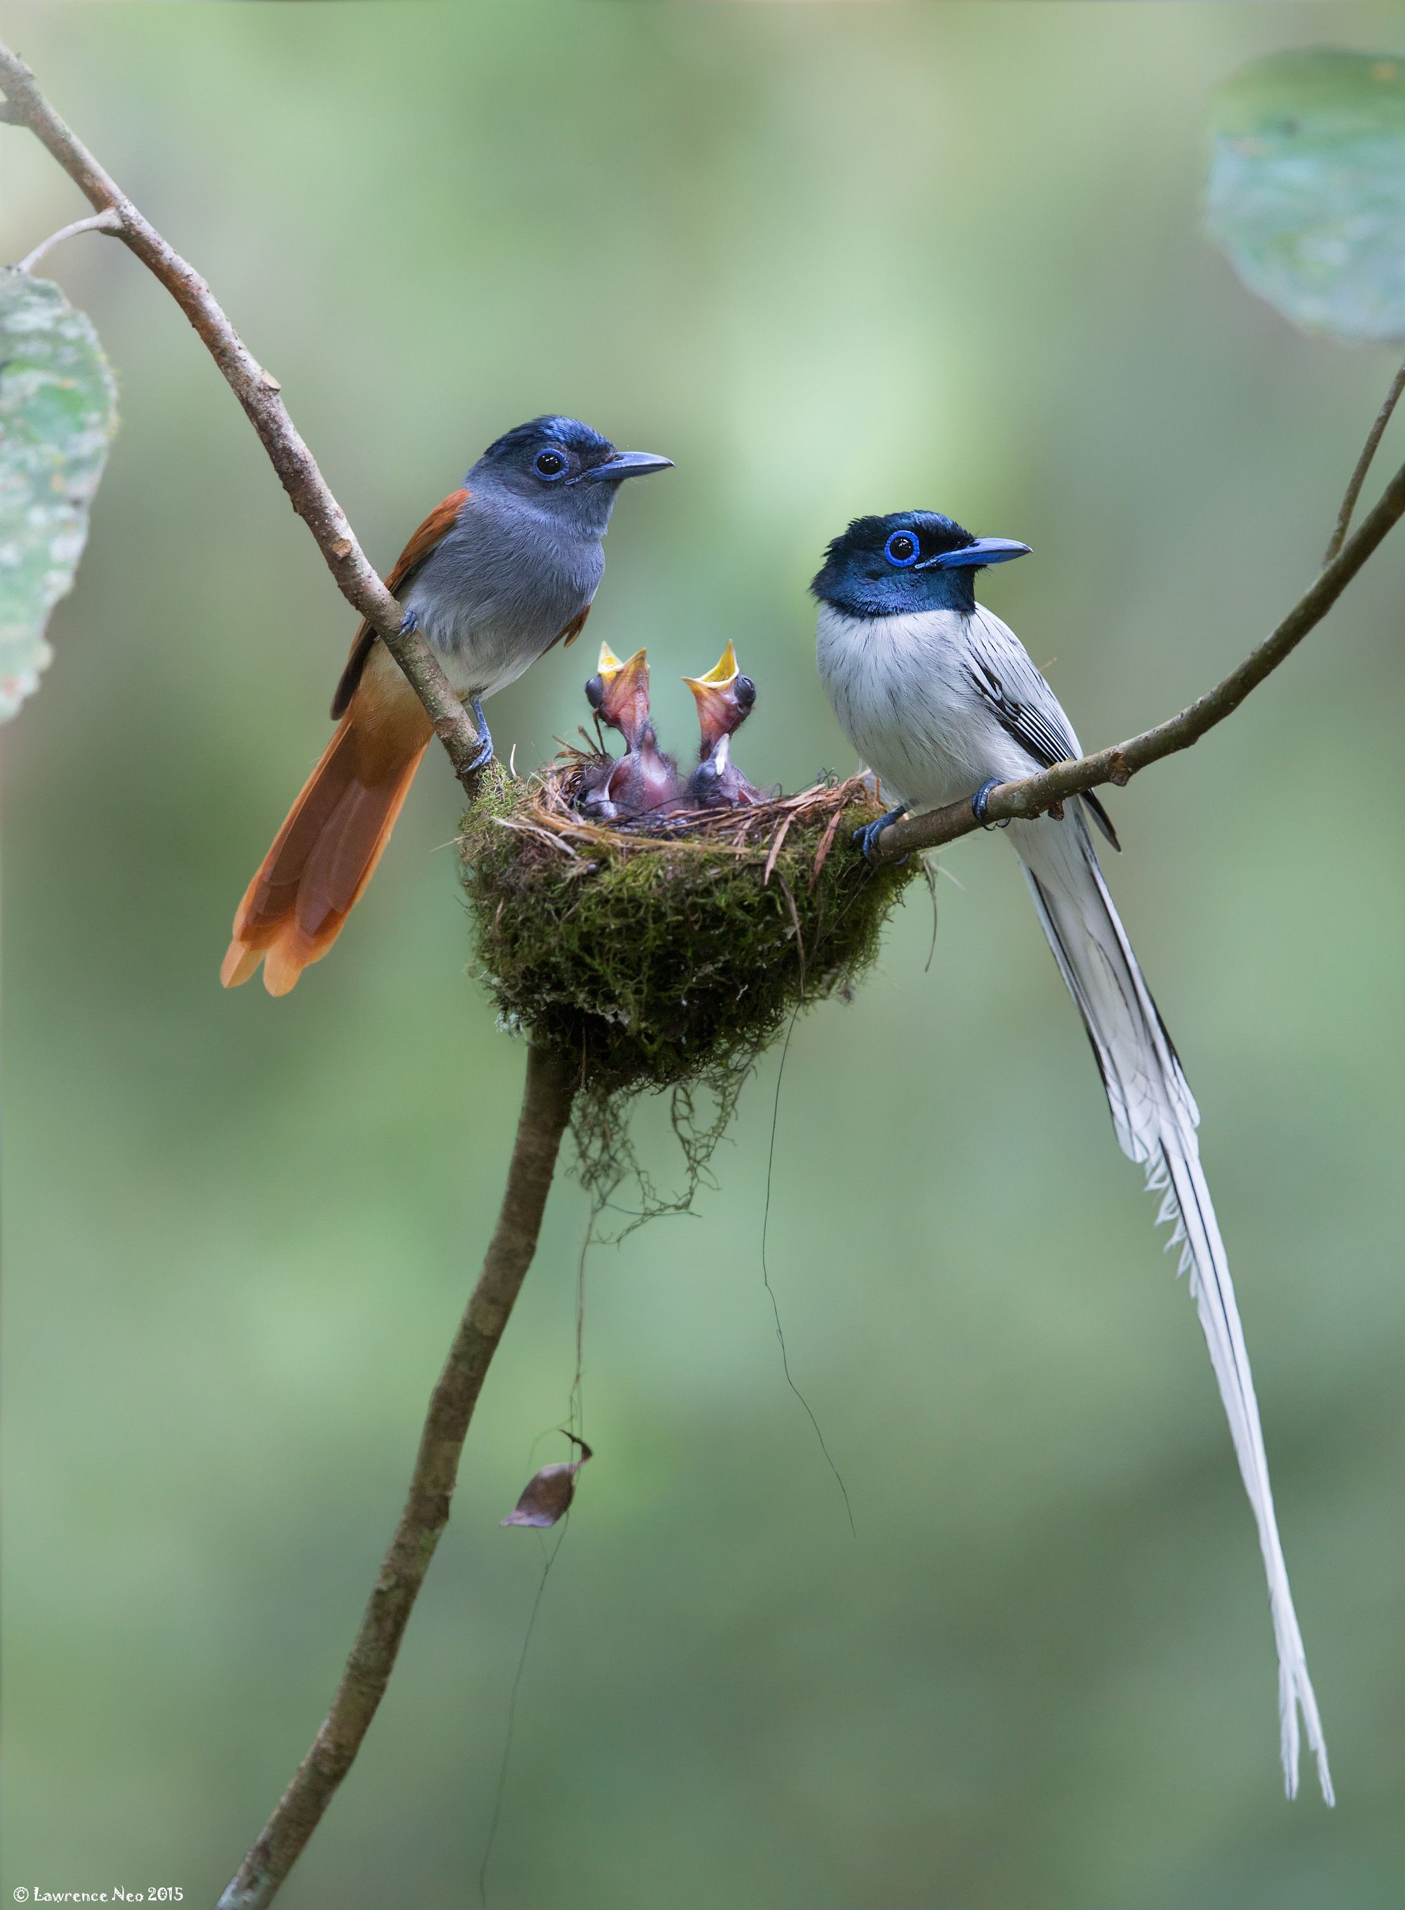
Asian Paradise Flycatcher

Slide 16
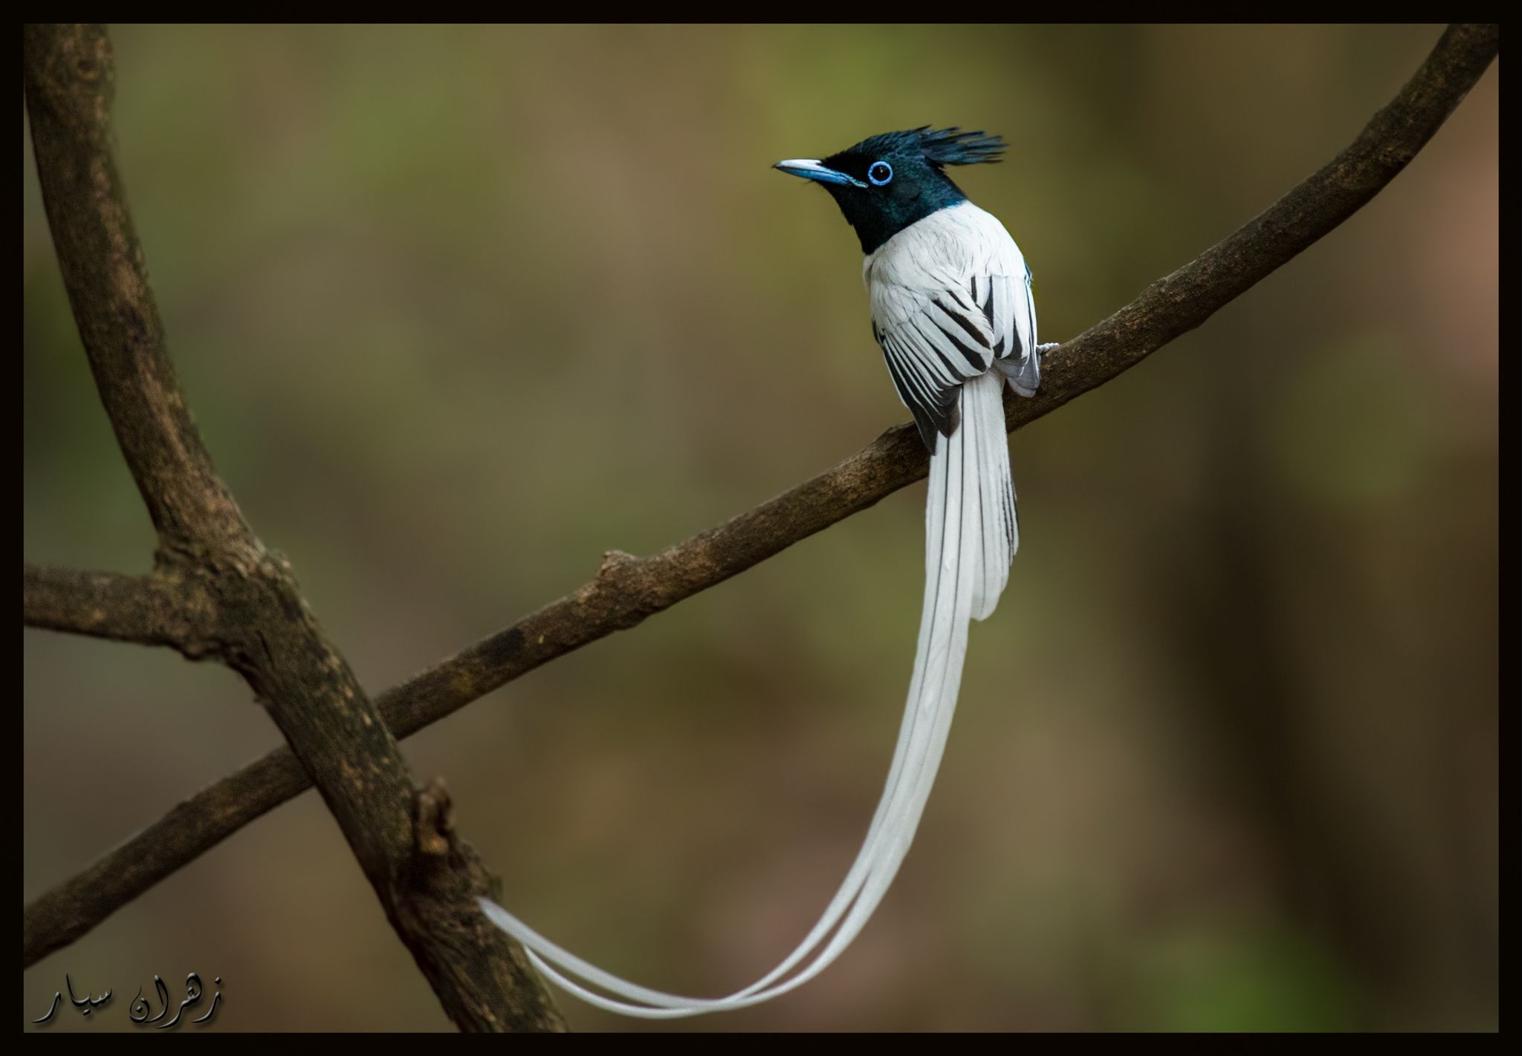
Asian Paradise Flycatcher

Slide 18

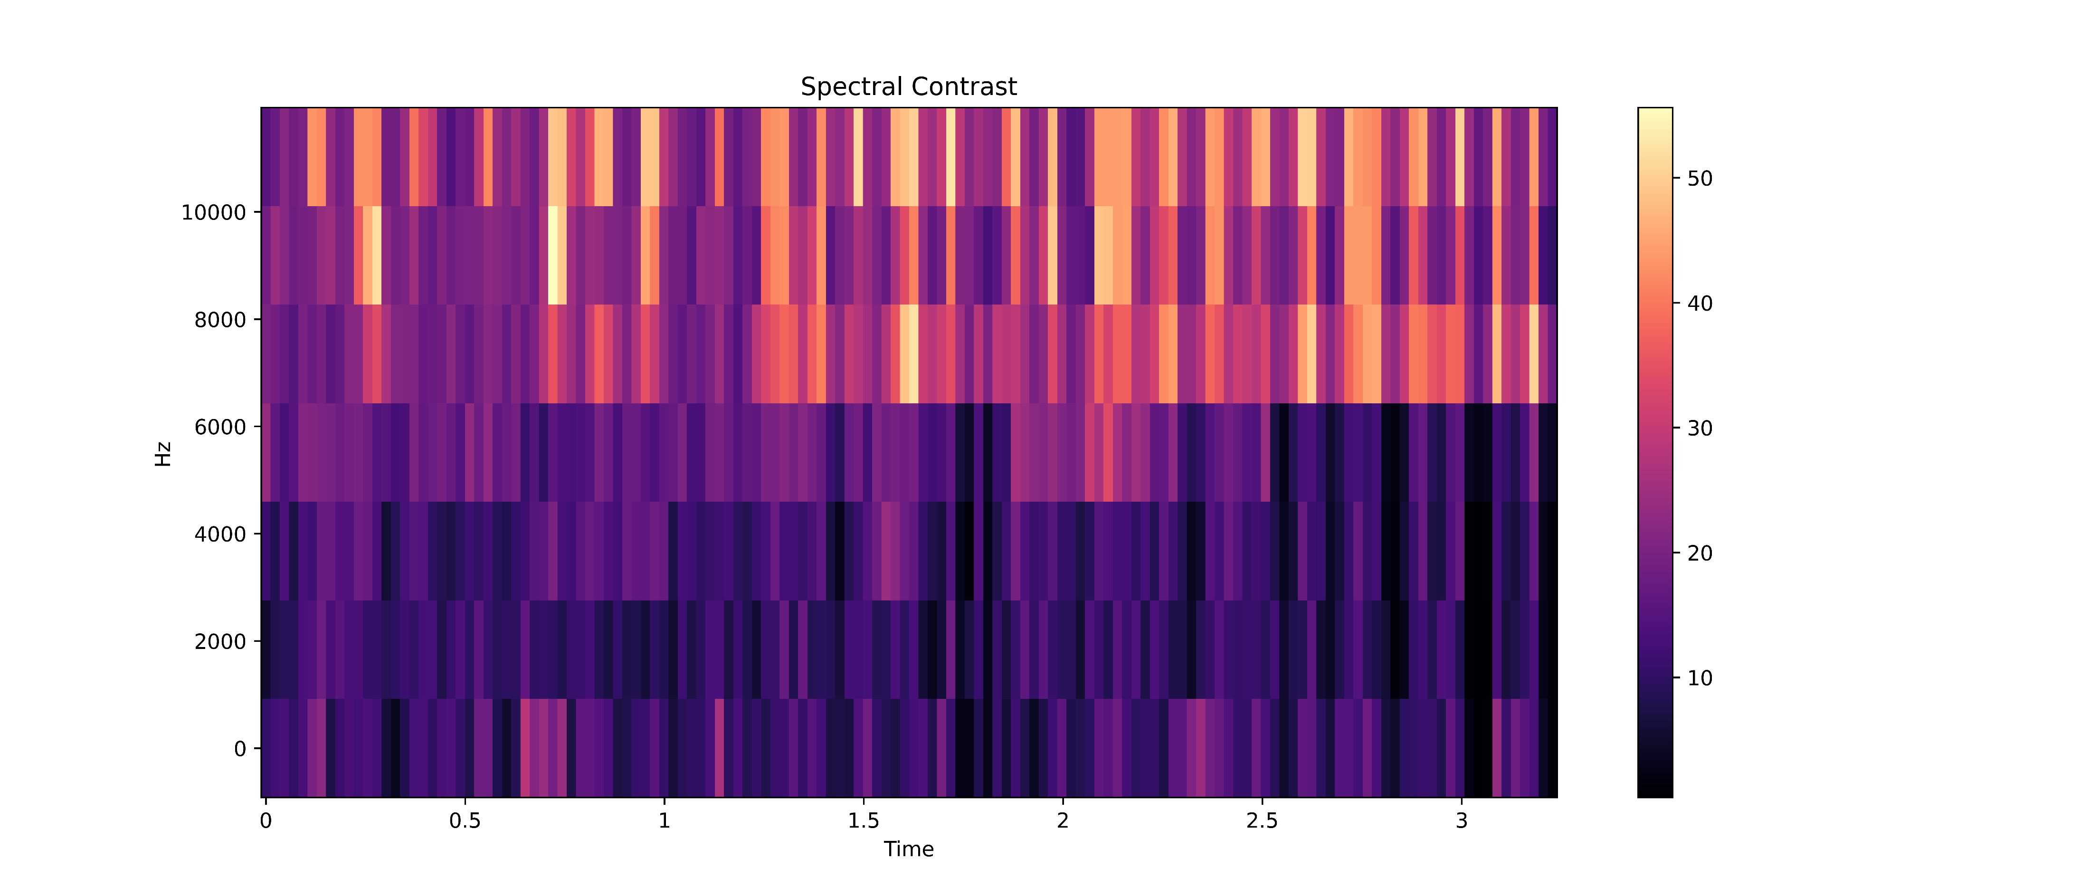
With removing silence
with noise
With removing silence
without noise

Slide 19
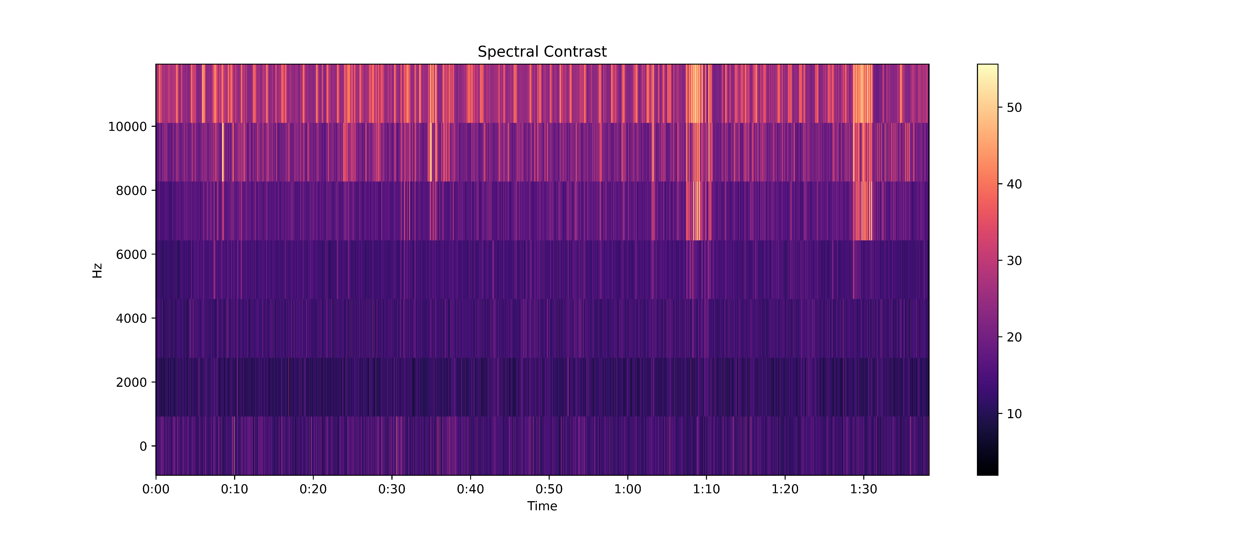
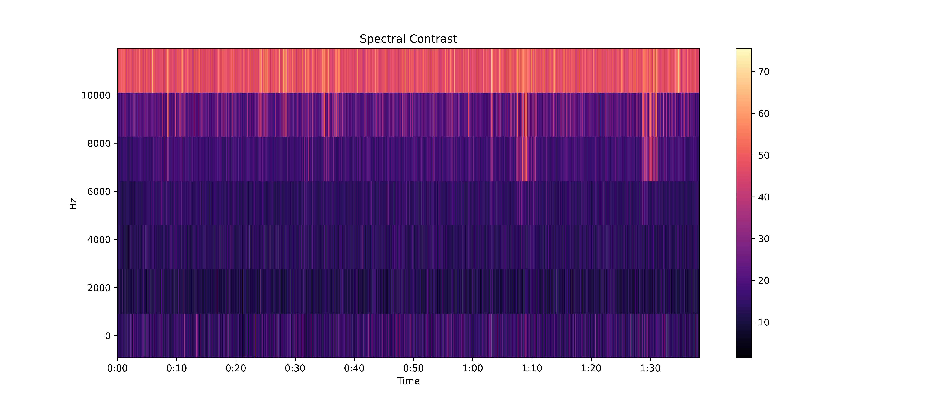
With silence
with noise
With silence
without noise
(default)

Slide 20

Short-Time Transform Fourier spectrogram
 | ResNet | ResNet+rs | EfficientNet | EfficientNet+rs
F1-score | 0.403 | 0.332 | 0.400 | 0.283
Precision | 0.411 | 0.338 | 0.413 | 0.294
Recall | 0.424 | 0.356 | 0.414 | 0.300
Accuracy | 0.570 | 0.500 | 0.570 | 0.432

Slide 21
Mel spectrogram
 | ResNet | ResNet+rs | EfficientNet | EfficientNet+rs
F1-score | 0.424 | 0.360 | 0.429 | 0.299
Precision | 0.435 | 0.369 | 0.437 | 0.310
Recall | 0.443 | 0.381 | 0.451 | 0.318
Accuracy | 0.586 | 0.519 | 0.594 | 0.451

Slide 22
Constant Q Transform spectrogram
 | ResNet | ResNet+rs | EfficientNet | EfficientNet+rs
F1-score | 0.246 | 0.226 | 0.272 | 0.177
Precision | 0.253 | 0.233 | 0.277 | 0.181
Recall | 0.267 | 0.248 | 0.296 | 0.196
Accuracy | 0.359 | 0.341 | 0.412 | 0.283

Slide 23
Spectral Contrast spectrogram
 | ResNet | ResNet+rs | EfficientNet | EfficientNet+rs
F1-score | 0.171 | 0.154 | 0.187 | 0.122
Precision | 0.175 | 0.156 | 0.189 | 0.122
Recall | 0.194 | 0.180 | 0.211 | 0.145
Accuracy | 0.275 | 0.254 | 0.306 | 0.211

Slide 24
Chroma Contrast spectrogram
 | ResNet | ResNet+rs | EfficientNet | EfficientNet+rs
F1-score | 0.202 | 0.183 | 0.207 | 0.140
Precision | 0.204 | 0.189 | 0.220 | 0.138
Recall | 0.232 | 0.206 | 0.222 | 0.173
Accuracy | 0.326 | 0.291 | 0.326 | 0.239

Slide 25
Label Smoothing
 | ResNet | ResNet+rs | EfficientNet | EfficientNet+rs
F1-score | 0.436 | 0.373 | 0.443 | 0.318
Precision | 0.446 | 0.378 | 0.451 | 0.329
Recall | 0.456 | 0.399 | 0.463 | 0.337
Accuracy | 0.600 | 0.525 | 0.603 | 0.468

Slide 26
Augmentations
 | ResNet | ResNet+rs | EfficientNet | EfficientNet+rs
F1-score | 0.393 | 0.341 | 0.417 | 0.295
Precision | 0.408 | 0.352 | 0.426 | 0.307
Recall | 0.409 | 0.358 | 0.436 | 0.314
Accuracy | 0.557 | 0.502 | 0.586 | 0.443

Slide 28
Label Smoothing
Mel spectrogram
Augmentations

